Slide 1
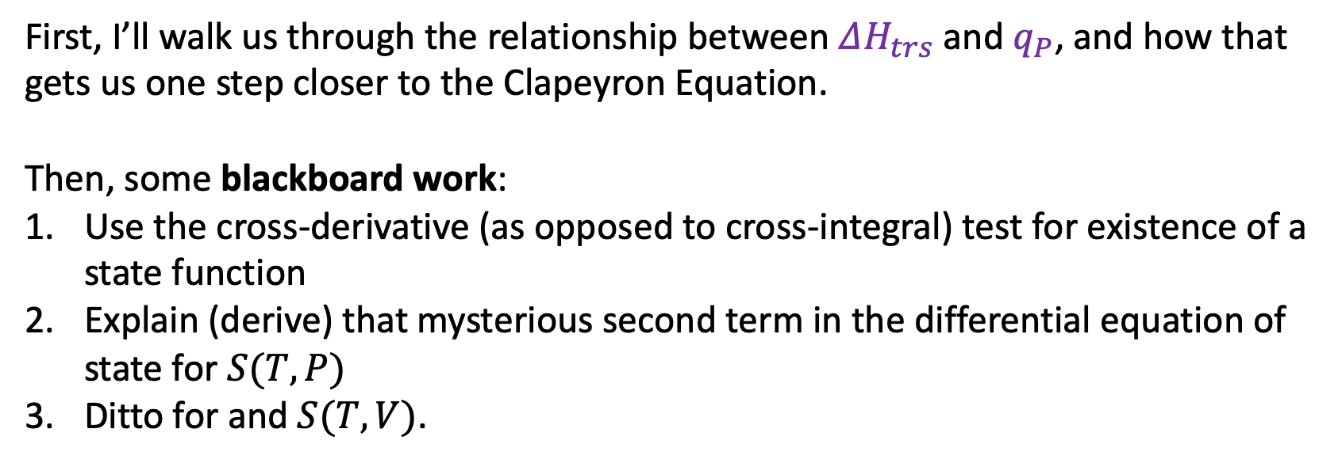
Roadmap for today
First, I’ll walk us through the relationship between $ΔH_{trs}$ and $q_{P}$, and how that gets us one step closer to the Clapeyron Equation.
Then, some blackboard work:
Use the cross-derivative (as opposed to cross-integral) test for existence of a state function
Explain (derive) that mysterious second term in the differential equation of state for $S(T,P)$
Ditto for and $S(T,V)$.

Slide 2
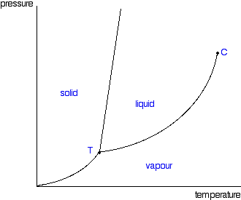

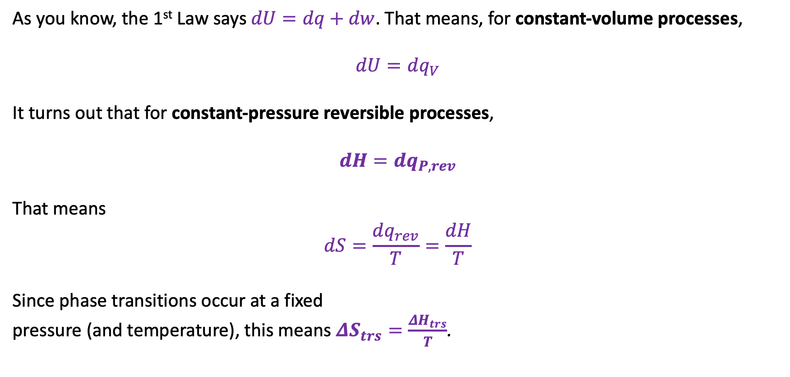
$ΔH_{trs}$ , $q_{P}$, and getting one step closer to the Clapeyron Equation
As you know, the 1st Law says $dU=dq+dw$. That means, for constant-volume processes,
$$dU=dq_{V}$$
It turns out that for constant-pressure reversible processes,
$$dH=dq_{P,rev}$$
That means
$$dS=\frac{dq_{rev}}{T}=\frac{dH}{T}$$
Since phase transitions occur at a fixed
pressure (and temperature), this means $ΔS_{trs}=\frac{ΔH_{trs}}{T}$.
$$∆S_{vap}$$
$$∆H_{vap}$$
$$∆V_{vap}$$

Slide 3
$ΔH_{trs}$ , $q_{P}$, and getting one step closer to the Clapeyron Equation
As you know, the 1st Law says $dU=dq+dw$. That means, for constant-volume processes,
$$dU=dq_{V}$$
It turns out that for constant-pressure reversible processes,
$$dH=dq_{P,rev}$$
That means
$$dS=\frac{dq_{rev}}{T}=\frac{dH}{T}$$
Since phase transitions occur at a fixed
pressure (and temperature), this means $ΔS_{trs}=\frac{ΔH_{trs}}{T}$.
You should probably commit this to memory too
$$∆S_{vap}$$
$$∆H_{vap}$$
$$∆V_{vap}$$

Slide 4
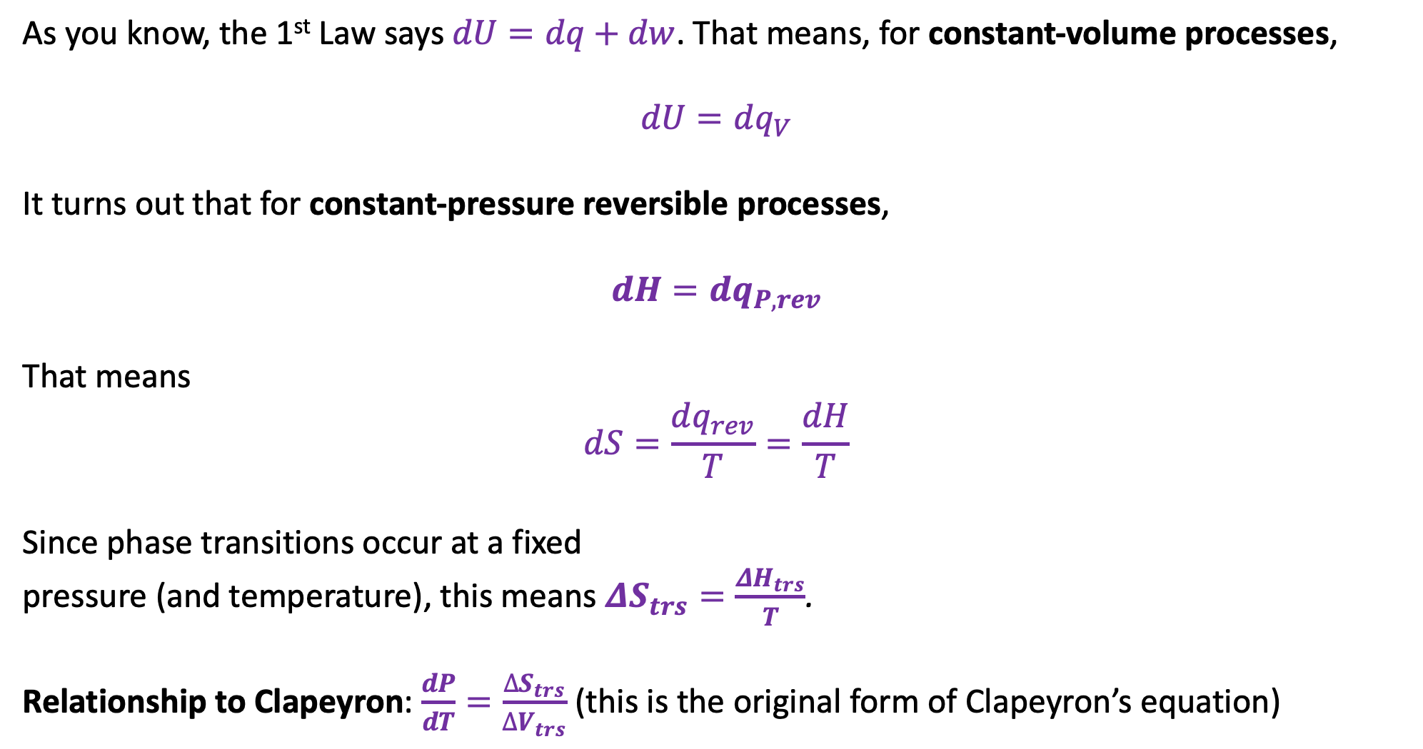
Getting one step closer to the Clapeyron Equation
As you know, the 1st Law says $dU=dq+dw$. That means, for constant-volume processes,
$$dU=dq_{V}$$
It turns out that for constant-pressure reversible processes,
$$dH=dq_{P,rev}$$
That means
$$dS=\frac{dq_{rev}}{T}=\frac{dH}{T}$$
Since phase transitions occur at a fixed
pressure (and temperature), this means $ΔS_{trs}=\frac{ΔH_{trs}}{T}$.
Relationship to Clapeyron: $\frac{dP}{dT}=\frac{∆S_{trs}}{∆V_{trs}}$ (this is the original form of Clapeyron’s equation)
You should probably commit this to memory too
$$∆S_{vap}$$
$$∆H_{vap}$$
$$∆V_{vap}$$

Slide 5
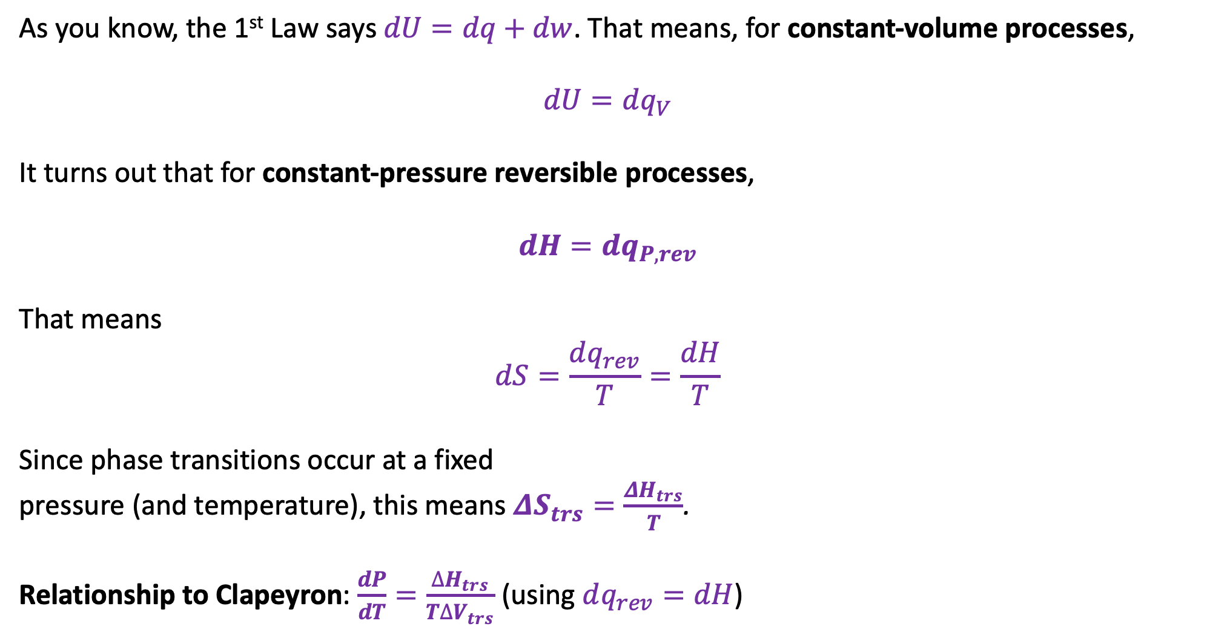
Getting one step closer to the Clapeyron Equation
As you know, the 1st Law says $dU=dq+dw$. That means, for constant-volume processes,
$$dU=dq_{V}$$
It turns out that for constant-pressure reversible processes,
$$dH=dq_{P,rev}$$
That means
$$dS=\frac{dq_{rev}}{T}=\frac{dH}{T}$$
Since phase transitions occur at a fixed
pressure (and temperature), this means $ΔS_{trs}=\frac{ΔH_{trs}}{T}$.
Relationship to Clapeyron: $\frac{dP}{dT}=\frac{∆H_{trs}}{T∆V_{trs}}$ (using $dq_{rev}=dH$)
You should probably commit this to memory too
$$∆S_{vap}$$
$$∆H_{vap}$$
$$∆V_{vap}$$

Slide 6
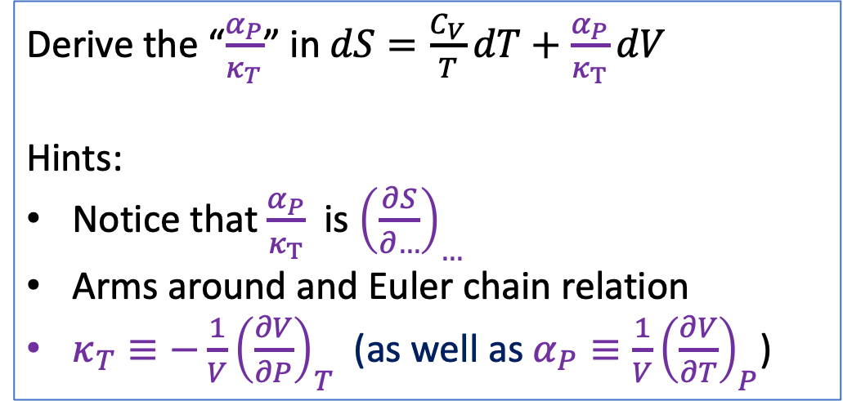
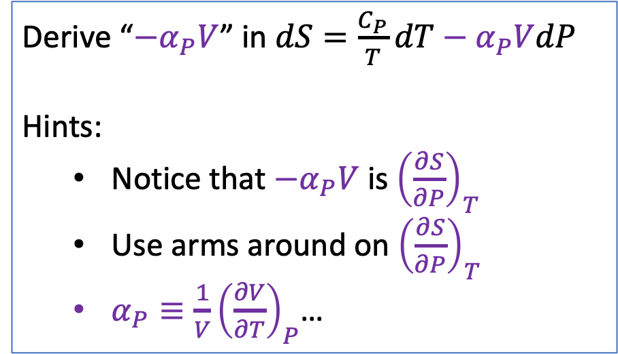
Blackboard tasks #1 and #2
Derive “${−α}_{P}V$” in $dS=\frac{C_{P}}{T}dT−α_{P}VdP$
Hints:
Notice that $−α_{P}V$ is ${\left(\frac{∂S}{∂P}\right)}_{T}$
Use arms around on ${\left(\frac{∂S}{∂P}\right)}_{T}$
$α_{P}≡\frac{1}{V}{\left(\frac{∂V}{∂T}\right)}_{P}$…
Derive the “$\frac{α_{P}}{κ_{T}}$” in $dS=\frac{C_{V}}{T}dT+\frac{α_{P}}{κ_{T}}dV$
Hints:
Notice that $\frac{α_{P}}{κ_{T}}$ is ${\left(\frac{∂S}{∂…}\right)}_{…}$
Arms around and Euler chain relation
$κ_{T}≡−\frac{1}{V}{\left(\frac{∂V}{∂P}\right)}_{T}$ (as well as $α_{P}≡\frac{1}{V}{\left(\frac{∂V}{∂T}\right)}_{P}$)

Slide 7
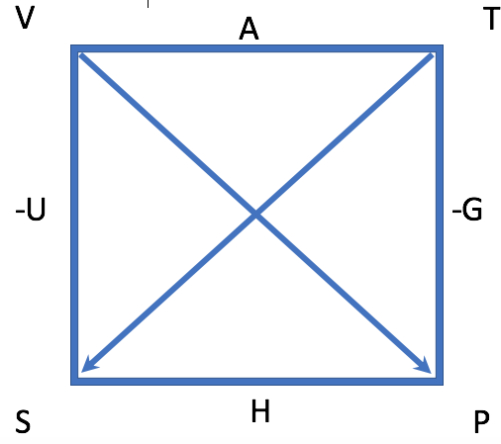
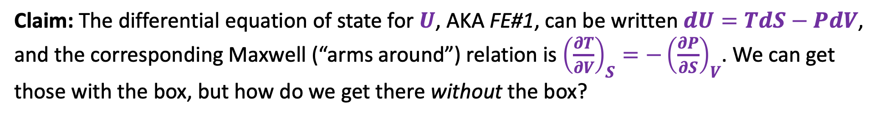
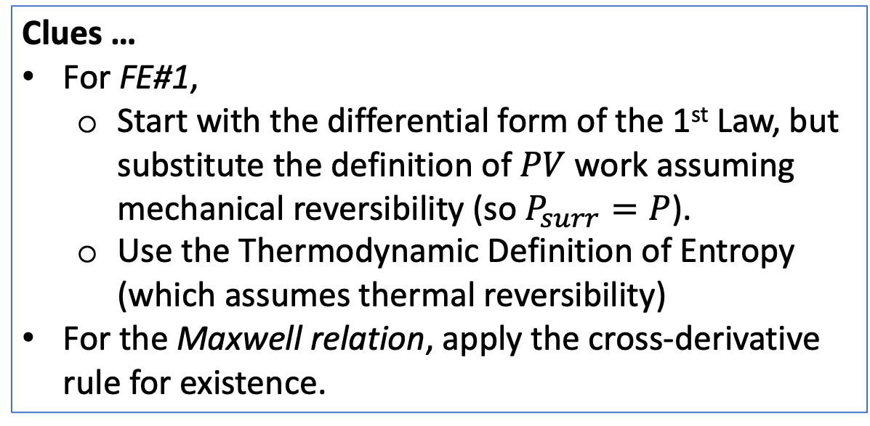
Blackboard task #3: Deriving the First Fundamental Equation of Thermodynamics
Claim: The differential equation of state for $U$, AKA FE#1, can be written $dU=TdS−PdV$, and the corresponding Maxwell (“arms around”) relation is ${\left(\frac{∂T}{∂V}\right)}_{S}=−{\left(\frac{∂P}{∂S}\right)}_{V}$. We can get those with the box, but how do we get there without the box?
Clues …
For FE#1,
Start with the differential form of the 1st Law, but substitute the definition of $PV$ work assuming mechanical reversibility (so $P_{surr}=P$).
Use the Thermodynamic Definition of Entropy (which assumes thermal reversibility)
For the Maxwell relation, apply the cross-derivative rule for existence.
By the way: There are actually three other Fundamental Equations, but these others are basically restatements of the same idea.

